Slide 1
Student Voice Survey 2
Reviewing 2023/2024 Student Voice Priorities

Slide 2
Student Voice Survey 2
2023/2024
324 responses
Underrepresented Group | Number of Responses
Postgrad | 3
LGBTQ+ | 35
Commuter (self-declared) | 33
Mature | 27
Students with disabilities | 90
International | 19
BAME | 11

Slide 3
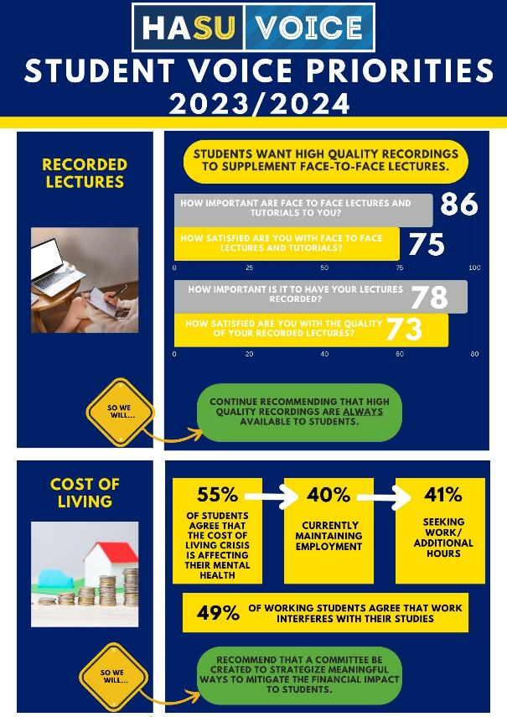

Slide 5
Timetabling Difficulties
Please let us know of any experiences that you've had with timetabling by checking all that apply.
2022/2023
480 responses
2023/2024
268 responses

Slide 6
Timetabling Difficulties
To what extent do you agree that changes to your lecture/tutorial schedule have impacted you negatively?
2022/2023
480 responses
2023/2024
268 responses

Slide 7
Timetabling Difficulties
How often do you experience changes to your timetable (time or location) with less than 24 hours notice?
2022/2023
480 responses
2023/2024
268 responses

Slide 8
Timetabling Difficulties
Have you experienced a lecturer/support staff not arrive for a scheduled lecture/tutorial?
2022/2023
480 responses
2023/2024
268 responses

Slide 9
Timetabling Difficulties
To what extent do you agree with the following: "changes to my timetable are communicated to me clearly and with sufficient time to make adjustments"?
2022/2023
480 responses
2023/2024
268 responses

Slide 10
Has there been a review of timetabling?
Do students know if there has?
What are our priorities for 2024/2025?

Slide 12
Considering Harper’s estates and facilities as they are, which 3 areas of campus would YOU prioritise for investment?
48.58%
32.08%
29.72%
25%
17.45%
SU Facilities
Informal Learning/Socializing Space
Library
Parking/Road Conditions
Accommodation
Shown as percentage of all responses.
Notes:
SU Facilities includes the Barn, Welly, gym, Rugby pitch, sports facilities

Slide 13
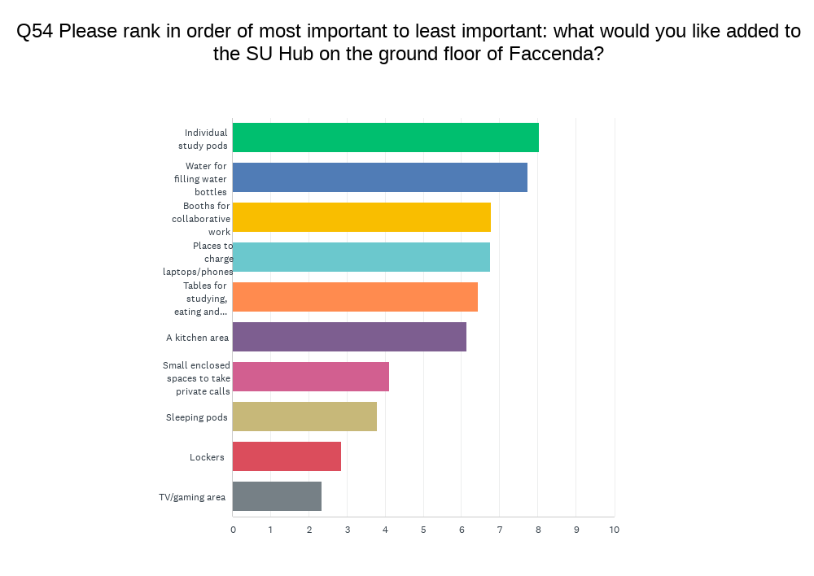
What would you like added to the SU Hub on the ground floor of Faccenda?
Average Ranking with Weighted Distribution

Slide 14
2024/2025

Slide 15
What inspires you, or would inspire you, to attend lectures more frequently?
With few exceptions, students responded in one of three ways.
46%
Students said they would be more inspired to attend lectures if the lectures were more engaging.
They used words like…
passion
interactive
not reading from PowerPoint

Slide 16
What inspires you, or would inspire you, to attend lectures more frequently?
With only a few exceptions, students responded in one of three ways.
27%
Students said they would be more inspired to attend lectures if the content was improved.
They used words like…
relevant (especially to the current assignment)
challenging
interesting

Slide 17
What inspires you, or would inspire you, to attend lectures more frequently?
With only a few exceptions, students responded in one of three ways.
13%
Students said they would be more inspired to attend lectures if timetabling difficulties were solved.
They used words like…
too early
too spread out
too clumped together

Slide 18
What factors make it difficult for you to attend lectures/tutorials?
2023/2024
268 responses
Completing other assignments
I can learn the material without attending
Physical health problems
Lack of interest in the lecture material
Quality of the lecture not worth attending
Mental health problems

Slide 19
What factors make it difficult for you to attend lectures/tutorials?
2023/2024
268 responses
Extra-curricular/personal activity
Started too early
Transportation problems
Working for pay
N/A have not missed a lecture
Childcare

Slide 20
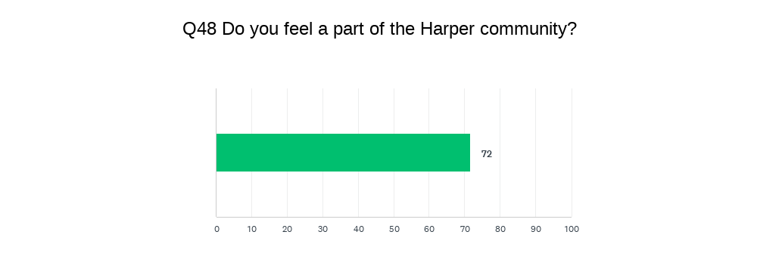
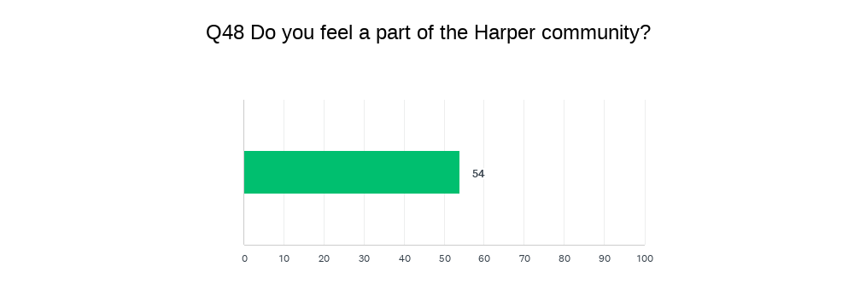
Have you joined an SU club or society this year?
Yes
No
Student Voice Survey 2023/2024

Slide 21
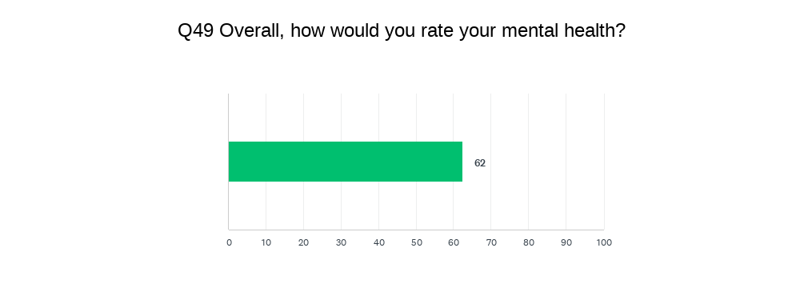
Have you joined an SU club or society this year?
Yes
No
Student Voice Survey 2023/2024

Slide 22
How often do you spend a Wednesday night in The Barn?
Never
Often
Student Voice Survey 2023/2024

